Slide 1
Capstone Project Presentation
Project : Supply Chain Management
Presented by – Anirban Maity
DSBA – March - 2022

Slide 2
Contents of Discussion
1. Business Problem Understanding ( Statement & Needs of the project, Business/Social opportunity )
2. Data description
3. Exploratory Data Analysis – Univariate & Bivariate
4. Model Building & Tuning
5. Model Performance Evaluation
6. Insights and Recommendation
Appendix

Slide 3
Business Problem Understanding
Problem Statement:
A FMCG company has entered into the instant noodles business two years back. Their higher management has notices that there is a miss match in the demand and supply. Where the demand is high, supply is pretty low and where the demand is low, supply is pretty high. In both the ways it is an inventory cost loss to the company; hence, the higher management wants to optimize the supply quantity in each and every warehouse in entire country.

Slide 4
Business Problem Understanding
Need of the Project/Study:
Management observed mismatch in Supply & Demand – Where Supply is High, Demand is Low.
Mismatch in Supply & Demands result - Inventory Cost Loss of the company, low profitability.
Warehouse maintenance Cost – including Govt. Approval & Renewal, breakdown cost, worker strike – leads more Inventory cost loss, low profitability.
Other Inventory cost - Transportation Cost & Transported Amount of product – leads to mismatch in Supply & Demand of the product in specific areas/zones => that leads to obtain a specific/optimum transported product details ( especially – Weight)

Slide 5
Business Problem Understanding
Business & Social Opportunity:
Objective of a business is – Maximizing the profitability, Minimizing the spending/cost.
The same can be achieved through 3 different steps –
Design ( Statistical Model Building)
Planning ( Trend Observation and trend analysis)
Execution ( Decision making by finalizing the analysis )
Objective for this problem is to build a statistical model -
A. To determine the optimum weight of the product shipped to Warehouse in each time.
B. To find the demand pattern in different areas in the country and arrange advertisement program and campaign depending upon the trend to maximize the profit.
C. Analyze the variable to find out the most important parameters
Steps Involved : - 1. Business Understanding & Collection of data
- 2. Preparing the data for analysis
- 3. Analyzing the 2 years old data to reach in a decision
- 4. Building Statistical Model
- 5. Getting some insights from the analysis
- 6. Implementation of outcomes for better profit.

Slide 6


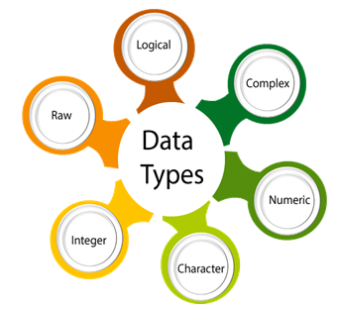


About the Data
Provided from Great Learning
Dataset Name : Data.csv
No Duplicate data
Data Contains :
Integer, Float, Categorical
25000 row, 24 Columns
15 - Independent – Integer
1 - Target Column – Integer
8 – Independent - categorical
Data Provided : Last 2 years data.
Some data with last 1 year or last 3 months.
1 year data - transport issue_l1y
3 month data - num_refill_req_l3m, govt_check_l3m
storage_issue_reported_l3m,
wh_breakdown_l3m

Slide 7


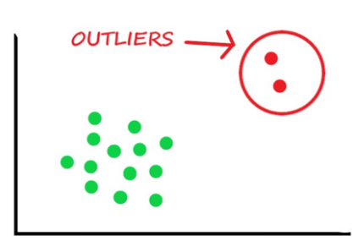



About the Data
3 Columns have Missing Data
2.3% of Total data
workers_num = 990
wh_est_year = 11881
approved_wh_govt_certificate = 908
Outliers present –
6 Independent columns
All columns renamed in Lower case
WH’ to ‘wh’
‘L’ to ‘l’ & ‘C’ to ‘c’
‘Ware_house’ to ‘wh’
approved_wh_govt_certificate – NA,C,B,B+,A,A+ : 0,1,2,3,4,5
Zone – East, North, South, West : 0,1,2,3
wh_owner_type – Company Owned, Rented : 0,1
location_type – Rural, Urban : 0,1
wh_capacity_size – Small, Mid, Large : 0,1,2
wh_regional_zone – Zone1 to Zone 6 : 1,2,3,4,5,6

Slide 8
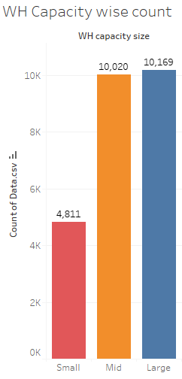
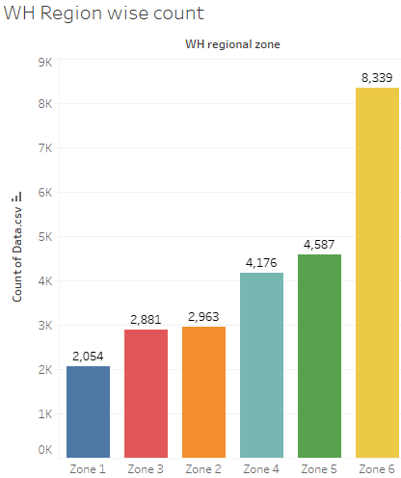
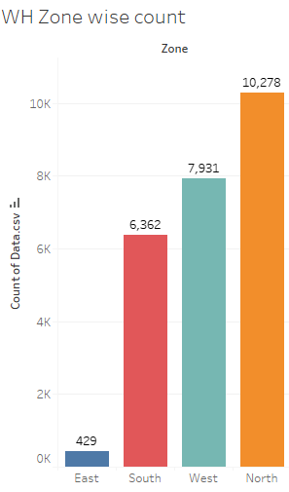
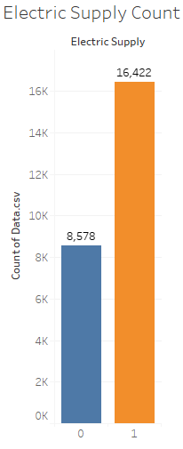
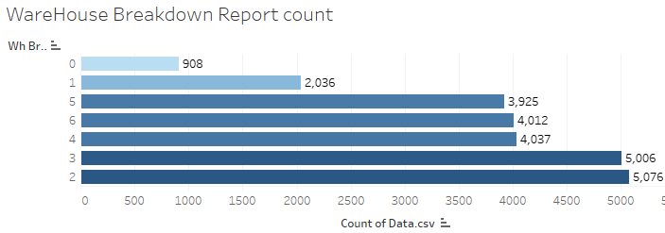
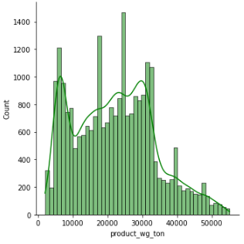
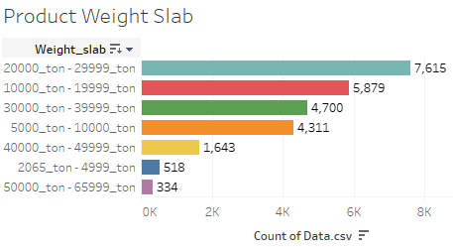
Univariate Analysis

Slide 9
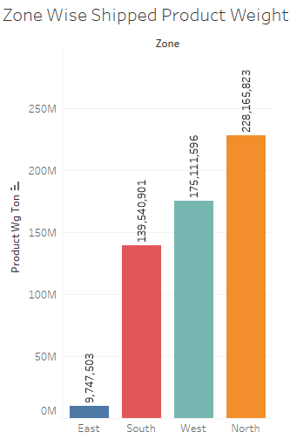
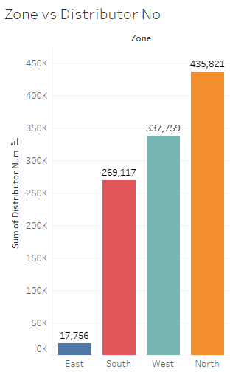
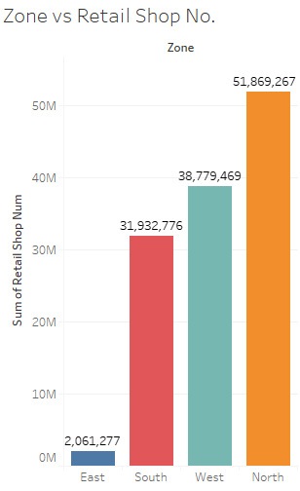
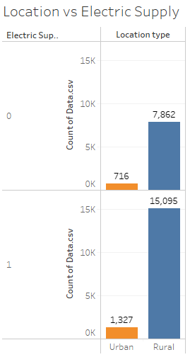
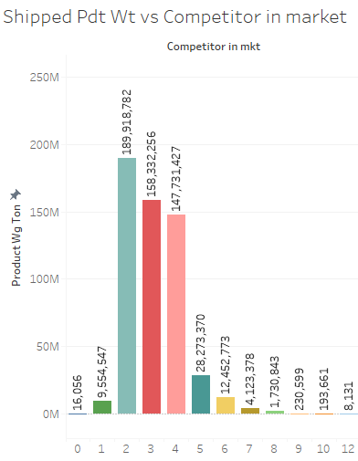
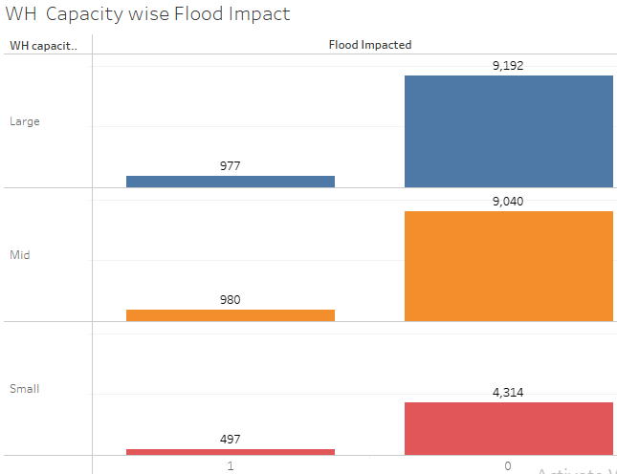
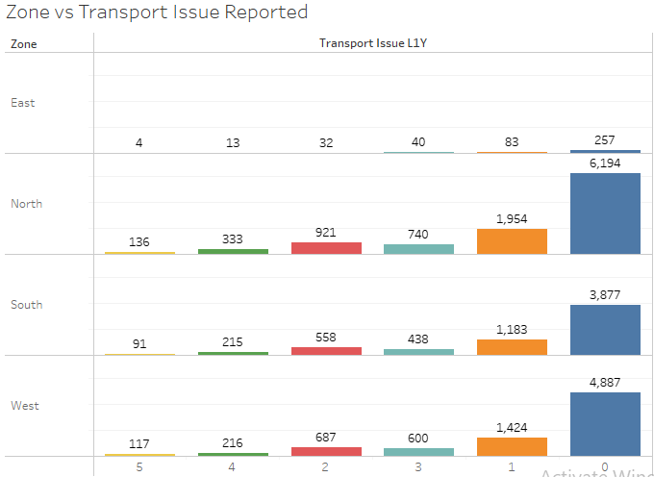
Bivariate Analysis

Slide 10
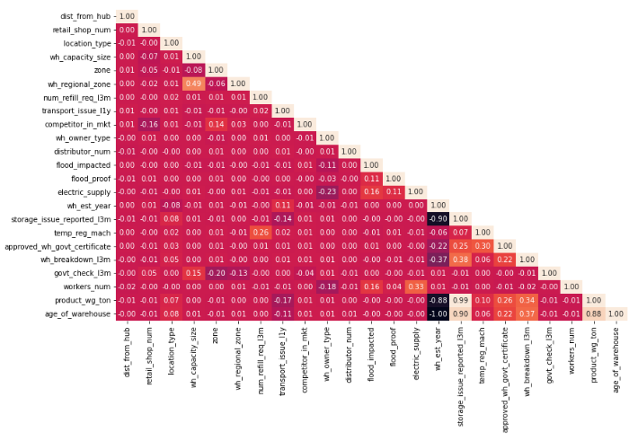
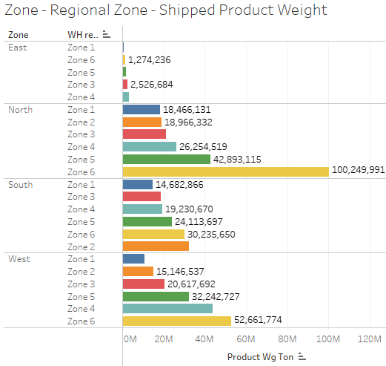
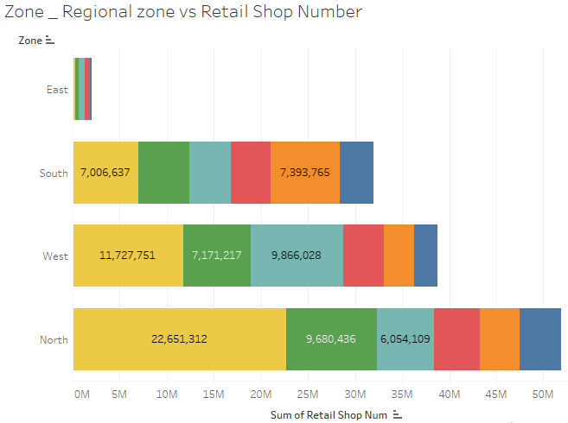
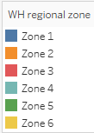
Multivariate Analysis

Slide 11
Data Preparation & Missing value Treatment
EDA – Dropping off Columns:
We have dropped – 2 columns which have no use (unique value) in model building – ‘wh_id’, & ‘wh_manager_id’.
EDA – Addition of new Variable:
‘Age_of_warehouse’ added - subtracting it’s establishment year from present time.
EDA – Null Value Check & Treatment:
As Null value < 15%, We have used KNN Imputer to impute the Null values.
‘workers_num’ – imputed with front fill method.
‘wh_est_year’ – imputed with mode value i.e. 2002.
‘approved_wh_govt_certificate’ - imputed with new category i.e. NA - encoded as 0.
EDA – Scaling : Generalization of data:
- Separate the Target column
- Separate the Continuous & Discrete columns
- Scale the Continuous column now.
Now the target column, scaled Continuous data and the categorical data – concatenated to get back whole dataset.

Slide 12
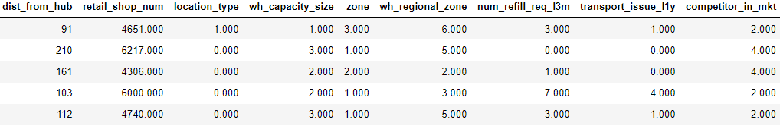
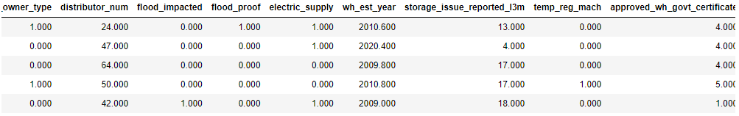
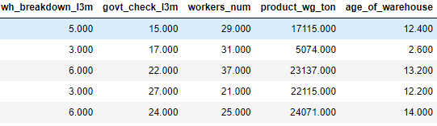
Model Building Data
Obtaining Final data for Model building :
The imputed data all the attributes should be whole number or integer number. After scaling the range of the data
changed for dist_from_hub & retails_shop_no. We will take the original data for these instead of scaled data.
This is final data for model building.

Slide 13
Modelling Approach
Different Regression Model will be built as Target Variable is Continuous:
Base Linear Model Selection
Linear Regression Model
Supervised Machine Learning Model – Splitting up data in 70:30
Presence of Multiple Independent attributes – Multilinear Regression Model
Presence of Multicollinearity – Independent Attributes highly correlated
Use of Shrinkage Method – Ridge Regression (L2) & Lasso Regression (L1) Model.
Non- Linear Regression Model
Non Linear Model Selection
Categorical attributes incorporated – possibility of violation of linear relationship
Improved Accuracy - Avoiding chances of Overfitting Model
Use of Non-Linear Regression Model – Random Forest Model, ANN Regression Model

Slide 14
Model Tuning – Improved Performance
Discussion on Evaluation Parameters :
Model Tuning
Maximizing model's performance without overfitting or creating too high of a variance.
Regularization Multilinear Regression Model: Ridge Regression , Lasso Regression Model
Grid Search CV : Combination of all possible Hyperparameters values is tried
Used in – all Non-Linear Models – Random Forest Model, ANN Regression Model
Model Performance
Metrics
R Square : measure of the goodness of fit of a model.
Adjusted R Square : Reliability of the model.
R Square & Adjusted R square – Needs to be closer to each other for a good model
MAPE: Mean Absolute Percentage Error
RMSE : Root Mean Square Error
RMSE – High value preferred, MAPE – lower value preferred for a good model.

Slide 15
Model Comparison
Model Name | R- Square |  | Adj. R Square |  | RMSE |  | MAPE
 | Train | Test | Train | Test | Train | Test | Train | Test
Multilinear Regression | 0.977 | 0.978 | 0.977 | 0.978 | 1775.317 | 1708.877 | 9.065 | 8.818
Ridge Regression | 0.977 | 0.978 | 0.977 | 0.978 | 1775.363 | 1709.145 | 9.046 | 8.801
Lasso Regression | 0.977 | 0.977 | 0.977 | 0.977 | 1775.842 | 1710.158 | 9.037 | 8.805
Decision Tree Regression | 1.0 | 0.988 | 1.0 | 0.988 | 0.0 | 1226.176 | 0.0 | 4.743
Decision Tree Regression Tuned | 0.949 | 0.948 | 0.949 | 0.948 | 2613.425 | 2615.521 | 10.675 | 10.757
Random Forest Regression | 0.999 | 0.994 | 0.999 | 0.994 | 348.223 | 881.002 | 1.535 | 3.859
Random Forest Regression Tuned | 0.996 | 0.993 | 0.996 | 0.993 | 696.394 | 934.256 | 3.09 | 4.214
ANN Regression | 0.991 | 0.991 | 0.991 | 0.991 | 1060.276 | 1074.701 | 5.226 | 5.434
ANN Regression – Tuned | 0.992 | 0.991 | 0.992 | 0.991 | 1027.193 | 1046.441 | 5.018 | 5.25
Multilinear Regression Model also performs well enough- But MAPE is slight high , R Square value says this is an Overfitting model.
Ridge Regression Model has good RMSE value, also the MAPE value is quite low, but R Square value refers it as - Overfitting model.
Decision Tree model performs well, but the MAPE value for test set is too High.
Random Forest Model carries a good MAPE value, R square value after tuning -Overfitting . Low RMSE value compared to other models.
ANN Regression Model the MAPE goes down after tuning, and the RMSE value remains low.
Lasso Regression Model - R square and Adjusted R Square values do not have much difference both in Train and Test data, RMSE is quite high, MAPE is within the range
Model Comparison:
The final model on the basis of these parameters will be the – Lasso Regression Model

Slide 16
Insights
Insights from Model building:
The best model on basis of performance parameters is the – Lasso Model.
The most significant feature of the model is - storage_issue_reported_l3m, temp_reg_mach, approved_wh_govt_certificate.
All the Linear Regression Models perform well and the model is stable also.
Statsmodel – provides the statistical values with significant attributes.
Insights from EDA:
Strong +ve Correlation in between – Target variable & Storage Issue reported in last 3 months
Strong –ve correlation in between – Age of Warehouse vs Storage Issue reported in last 3 months
Mean Shipped Product weight is higher in East region, but Overall no product shipped is Lower in East.
Most number of distributors & Most no of Retail Shops belong to – North Zone.
Most Number of Ware Houses are in – Regional Zone 6.
Company uses – Large & Mid capacity Ware houses the most.
Highest Weighted Product has been shipped least number
Mid sized Ware houses requested most for refill in last 3 months (3 & 8 times).
No. of Warehouses in Urban Area much lower than Rural area

Slide 17
Recommendations
Recommendation 1
Management needs to look into those zones and need to improve the transport system where transport issue has been reported 5 times (348 cases ) in last 1 year.
Recommendation 2
Most warehouses are situated in Rural Area, Management need to build more Warehouses in Urban area too to increase demand & to maintain supply .
Recommendation 3
Almost 50% Warehouses do not have the Electric Supply, Management need to provide Electricity to maintain food from being stale, that create a loss.
There are good no of WH which are Flood Impacted (around 2500), Management need to look upon those warehouses to save cost, as it could lead to damage of the stored product which may incur loss in the business.
Recommendation 4
Recommendation 5
The Average Distance from Hub is much higher, Management need to look for nearby Warehouses to minimize the transportation cost
Recommendation 6
The Average Distance from Hub is much higher, Management need to look for nearby Warehouses to minimize the transportation cost

Slide 18
Recommendations
Management should need to focus on advertisement campaign on the East zone of each regional Zones where the number distributer is lower. Also they need to try to increase the distributor in those areas to increase the growth of the business
Recommendation 7
Recommendation 8
Management needs to convert Small WH to Mid/Large.. To maintain the supply of the product as - Less product weight indicates less product shipping.
Recommendation 9
Management need to look into the breakdown issue with much priority (The 2 and 3 times Breakdown report is Highest)so that the ware house remains active and no supply issue occurs which may impact the whole business.
Recommendation 10
As Small WH ships least amount of Weighted product, Management needs to convert Small WH to Mid/Large To maintain the supply of the product as - Less product weight indicates less product shipping.

Slide 19
Appendix
Exploratory data analysis and Model building and Optimization done on - Python.
Exploratory data analysis & Visualization done on – Tableau Public – Click Below
Supply Chain Analysis on Tableau Public Link
Supply Chain Analysis
Flow Chart
1.
Business Understanding
2. Data Preparation
3.
EDA
4.
Model Building
5.
Model Optimization
6.
Model Deploy
In
Production
Flow Chart
All the 6 steps have been performed.
Once the whole data is opened by the FMCG company we can explore more efficiently.

Slide 20
Thank You
----------------------------------------------------------------

